Slide 1
On Fairness and Calibration
Geoff Pleiss, Manish Raghavan, Felix Wu, Jon Kleinberg, Killian Q. Weinberger
Presenter: Xing Han, Yihao Feng
March 5, 2019
University of Texas at Austin

Slide 2
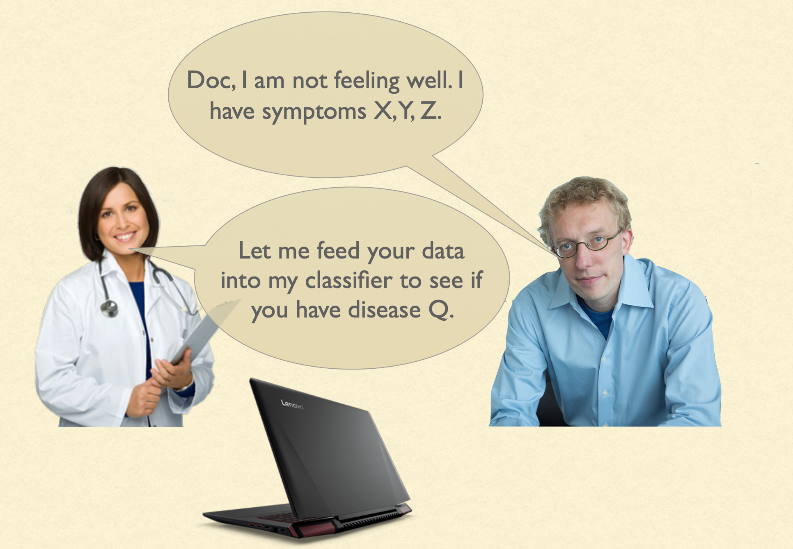

Slide 3
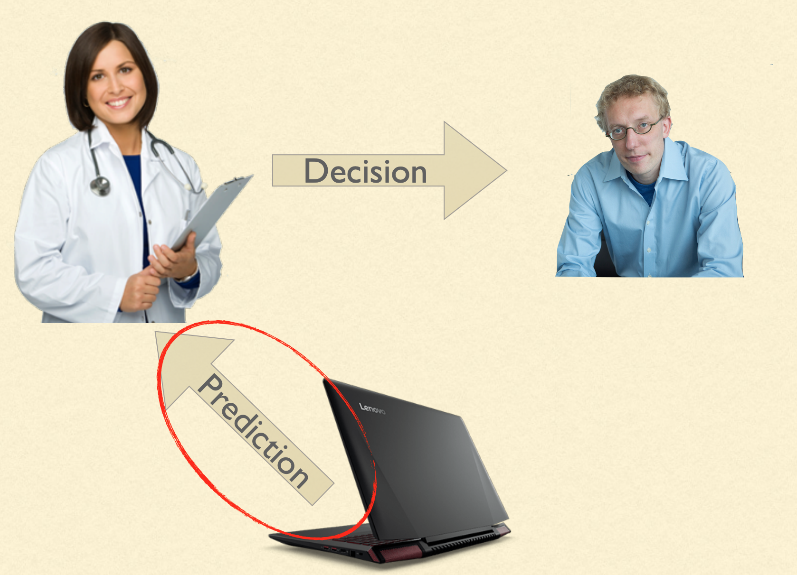
If you are the patient, what would you care most about the decisions made by ML algorithms?

Slide 4
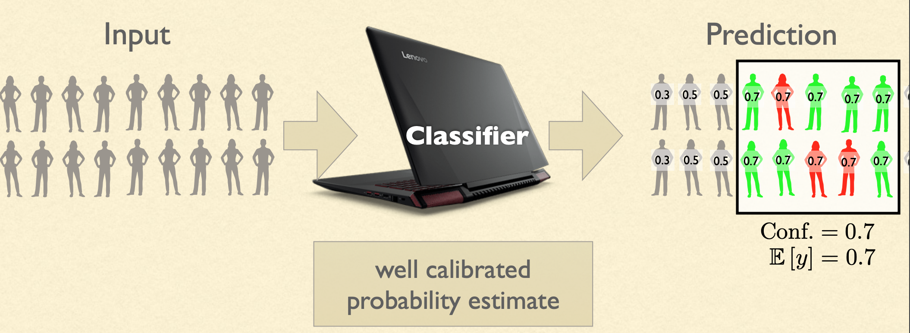
Calibrated Probability Estimates

Slide 5
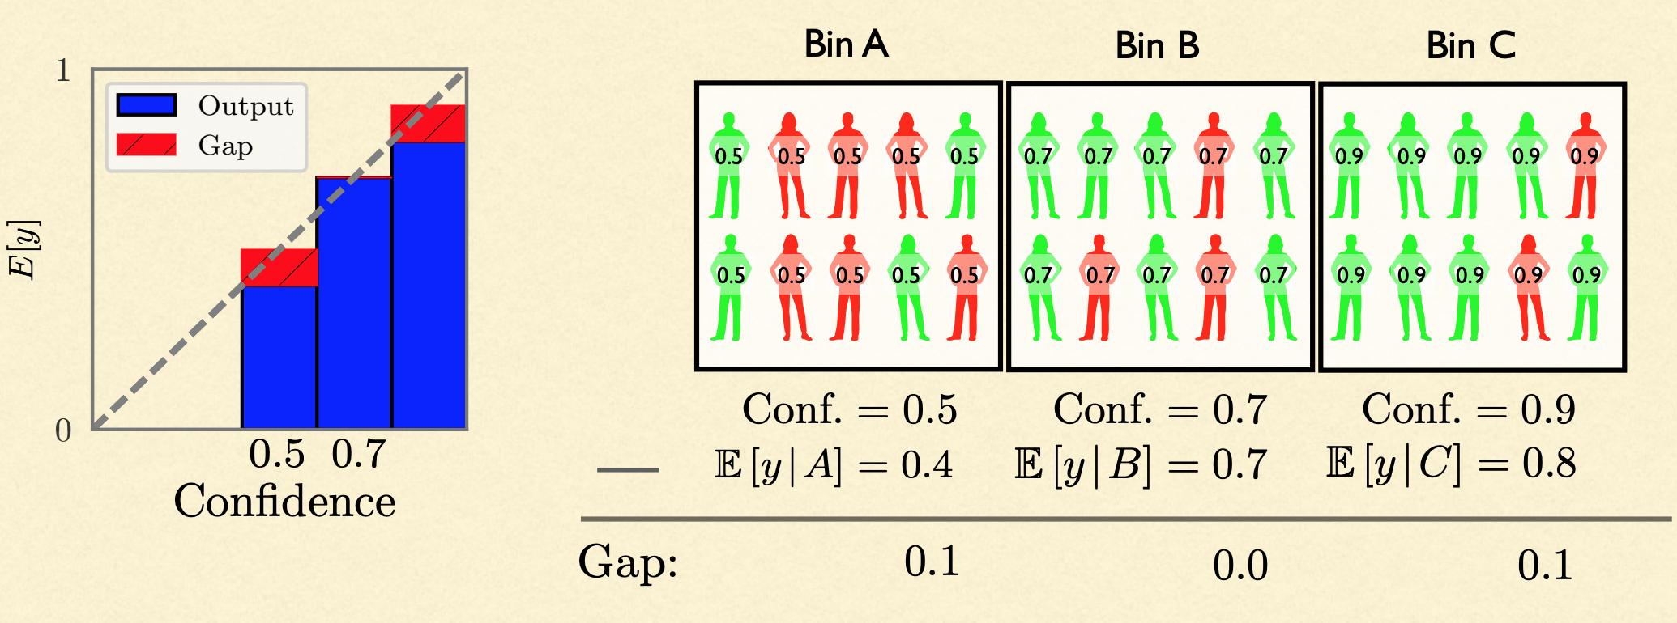
Miscalibrated Examples

Slide 6

See Also: ProPublica’s COMPAS Report

Slide 7
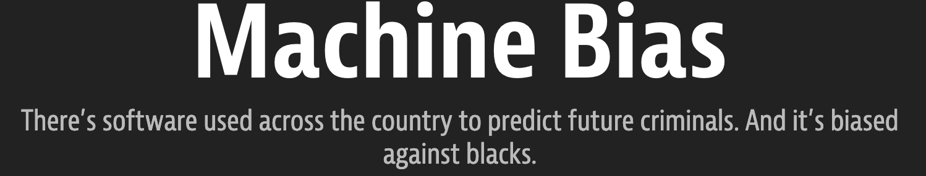
ProPublica’s findings about COMPAS risk tool:
African-American defendants who didn’t subsequently re-offended had higher average scores than white defendants who didn’t re-offended.
White defendants who subsequently re-offended had lower average scores than African-American defendants who re-offended.
A false positive error that can affect African-American defendants!

Slide 8
Motivations
Many classification problems involve estimating the probability of a person’s future outcome
Hiring: succeeding in job description
Education: succeeding in competitive program with limited slots
Criminal justice: recidivism (future re-offense)
Fairness is important, we want to mitigate bias of classifiers toward protected attributes.

Slide 9
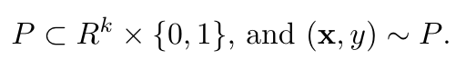
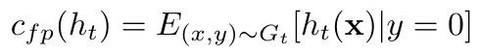
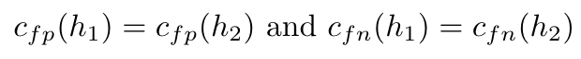
Equalized Odds - Problem Setup
Binary classification task:
Assume different base rate across two groups:
Define false positive (fp) rate and false negative (fn) rate of classifier, respectively:
To satisfy equalized odds, we need:

Slide 10
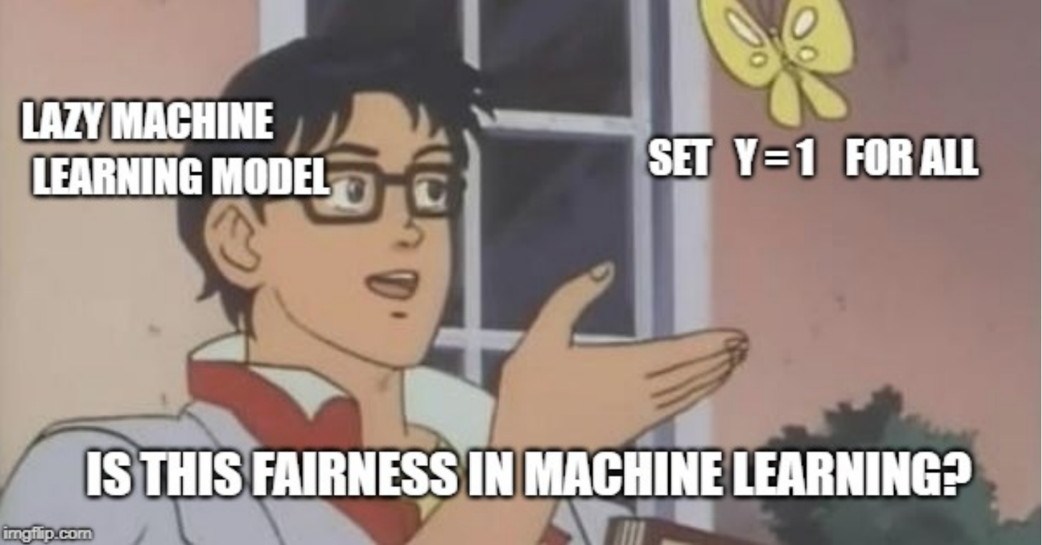
We want fairness, and also calibrated classifiers!

Slide 11
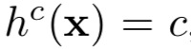
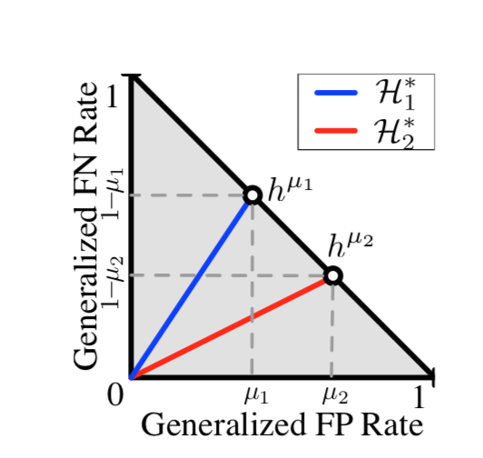
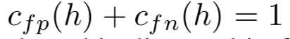
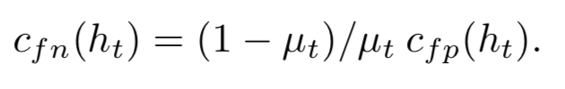
Geometric Characterization
Trivial classifiers:
Calibrated classifiers satisfies

Slide 12
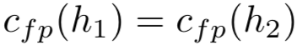
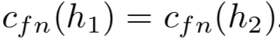
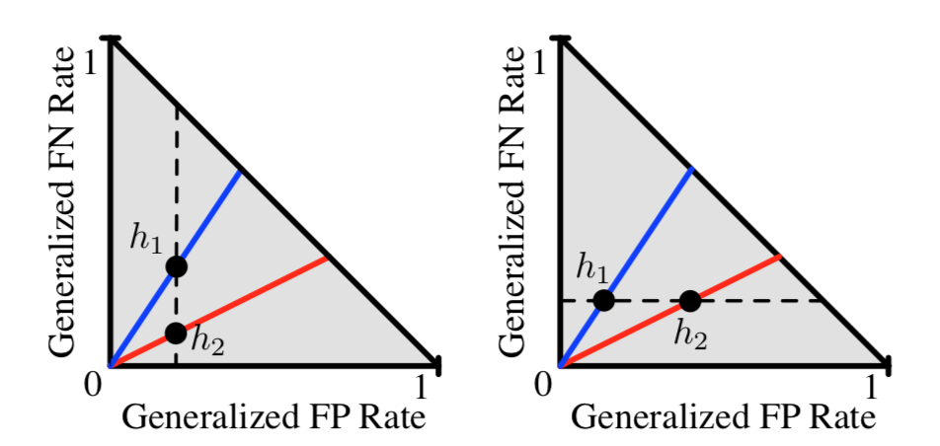
Geometric Characterization
Impossibility of Equalized Odds with Calibration

Slide 13
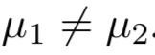
Geometric Characterization
Satisfy both calibration and equalized odds with
Only if both classifiers are perfect predictors!

Slide 14
Geometric Characterization
Satisfy both calibration and equalized odds with
Only if both classifiers are perfect predictors!
We can relax the equalized odds condition!

Slide 15
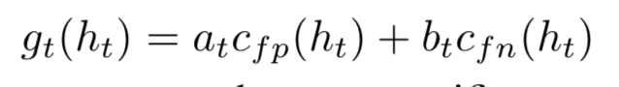
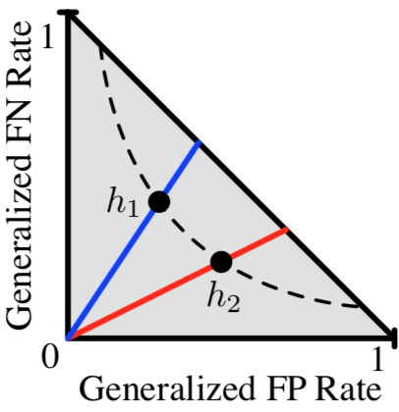
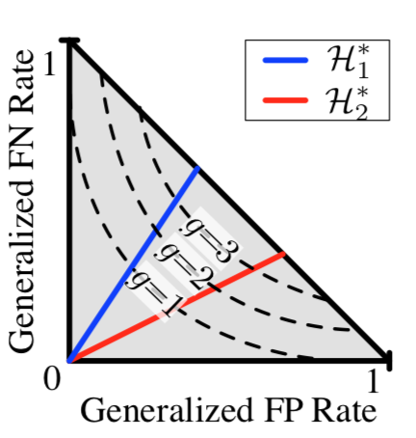
Geometric Characterization
Define another cost function for a group:
Unique solution for different level cost functions

Slide 16
How to find classifiers that satisfies both fairness and calibration?

Slide 17
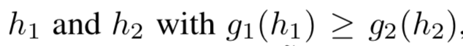
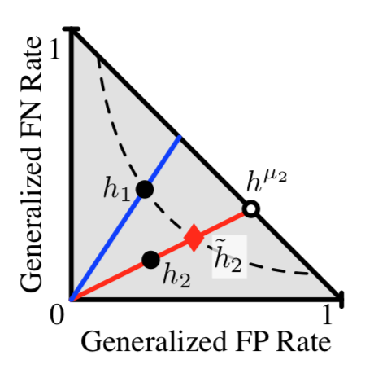
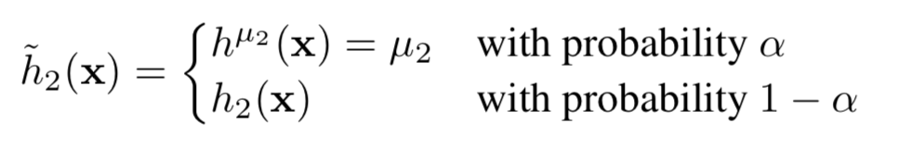
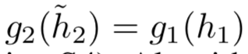
Post-processing to Satisfy Relaxed Equalized Odds
Given we can define a new classifier such that
We can solve alpha by

Slide 18
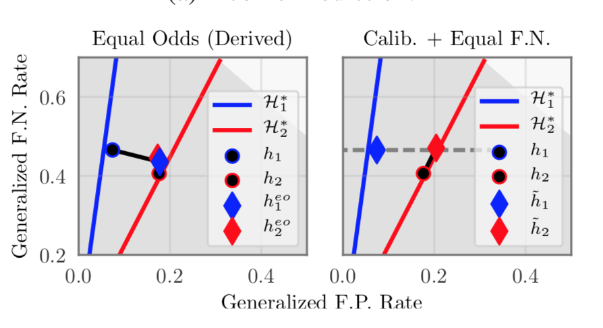
Example: Income Prediction

Slide 19
Conclusion & Discussion
The paper recovers the relationship between fairness and calibration
Maintaining cost parity and calibration is desirable yet often difficult.
The algorithm gives classifiers that satisfy in expectation, hard to use in practice due to randomization.
Gives a higher-error rate solution.

